Slide 1

Domain: MATLAB
Technology: COMMUNICATION
LOW-COMPLEXITY ACOUSTIC SCENE CLASSIFICATION IN DCASE 2022 CHALLENG

Slide 2
Index
Abstract
Introduction
Literature review
Existing Method
Disadvantages of Existing Method
Proposed method
Advantages of Proposed Method
Applications
Hardware and Software Requirements
Results
Conclusion
References

Slide 3
Abstract
The challenge was a continuation of the previous years', but the low-complexity requirements were amended to allow for a maximum of 128 K parameters, including any zero-valued ones, and a maximum of 30 million multiply-accumulate operations during inference time. A convolutional neural network used in the given baseline system uses post-training parameter quantization, yielding 46.5 K parameters and 29.23 million multiply-and-accumulate operations (MMACs). On the evaluation data, it performed with a 44.2% accuracy and 1.532 log-loss.Comparatively, the winning system in the competition, which had 121 K parameters and 28 MMACs, had an accuracy of 59.6% and a log loss of 1.091. 48 entries were submitted to the task by 19 different teams.

Slide 4
Introduction:
Classifying a brief audio clip into one of a preset set of classes that corresponds to the situation in which the audio was captured is the task of acoustic scene classification . Since the beginning of the DCASE Challenge, the challenge has been one of the key subjects, and it has evolved from the original setup to incorporate several new issues, such as multiple devices and low-complexity conditions . By specifying the low-complexity limitations, such as the limited number of parameters and the maximum number of operations permitted at inference time, typical of contemporary IoT devices, the current configuration moves closer to real-world applicability (or microcontrollers). For real-world applications, a classification method for acoustic scenes is expected to work in very diverse conditions, including audio captured with different devices and as short as possible inference time. The first task on low-complexity acoustic scene classification was defined in 2020 for only three classes and a single device , for which many submissions obtained very high performance. The solutions most commonly imposed restrictions on the model architectures, using slim models and depth-wise separable CNNs

Slide 5
Literature review:
S. NO | Journal Type with year | Authors | Title | Outcomes
1 | 2017, pp. 131–135. | S. Hershey, S. Chaudhuri, D. P. W. Ellis, J. F. Gemmeke, A. Jansen, R. C. Moore, M. Plakal, D. Platt, R. A. Saurous, B. Seybold, M. Slaney, R. J. Weiss, and K. Wilson | “CNN architectures for large-scale audio classification,” | International Conference on Acoustics, Speech and Signal Processing (ICASSP)
2 | May 2019, pp. 3852–3856. | J. Cramer, H.-H. Wu, J. Salamon, and J. P. Bello, | “Look, listen and learn more: Design choices for deep audio embeddings,” | in IEEE Int. Conf. on Acoustics, Speech and Signal Processing (ICASSP)
3 | May 2019, pp. 877–884 | S. Kumari, D. Roy, M. Cartwright, J. P. Bello, and A. Arora | “EdgeL3: Compressing L3-net for mote scale urban noise monitoring,” | in 2019 IEEE International Parallel and Distributed Processing Symposium Workshops (IPDPSW),
4 | vol. 29, pp. 1987–2000, 2021. | K. Koutini, H. Eghbal-zadeh, and G. Widmer | “Receptive field regularization techniques for audio classification and tagging with deep convolutional neural networks,” | IEEE/ACM Transactions on Audio, Speech, and Language Processing
5 | Tech. Rep., June 2021 | L. Pham, A. Schindler, H. Tang, and T. Hoang, | “DCASE 2021 task 1A: Technique report,” | DCASE2021 Challenge

Slide 6
Existing Method:
This paper presents the details of Task 1A Acoustic Scene Classification in the DCASE 2021 Challenge. The task targeted development of low-complexity solutions with good generalization properties. The provided baseline system is based on a CNN architecture and post-training quantization of parameters. The system is trained using all the available training data, without any specific technique for handling device mismatch, and obtains an overall accuracy of 47.7%, with a log loss of 1.473. The task received 99 submissions from 30 teams, and most of the submitted systems outperformed the baseline. The most used techniques among the submissions were residual networks and weight quantization, with the top systems reaching over 70% accuracy, and log loss under 0.8. The acoustic scene classification task remained a popular task in the challenge, despite the increasing difficulty of the setup.

Slide 7
Disadvantages of the Existing Method:
The speech Quality might be degraded
No robust Environment
Fail to encode the position and orientation of objects
Poor interpretability

Slide 8
Proposed method:
The baseline system is based on a convolutional neural network and has the same architecture as the 2021 system (CNN). Three CNN layers, one fully linked layer, and a softmax layer make up the system. The model is trained using a 16-batch size over 200 epochs. The code2 includes comprehensive model and parameter information. The feature extraction step adopts a conventional methodology, extracting log mel-band energies with a hop size of 50% every 40 ms. As a result, each audio file of one second has an input shape of 40 51. To simplify the model, post-training quantization to 8 bits is used.. Utilizing TFLite from TensorFlow 2.0 and assigning the weights to the INT8 type, the quantization was carried out after training. There are 46512 total parameters in the baseline system. The baseline system's overall performance based on system complexity data and development data.

Slide 9
Advantages of Proposed method:
Independently process the single images and thus even stationary objects can be detected
Can be used with the moving or Fixed cameras.
Fast to train the model
Capable to deal with any type of the noise

Slide 10
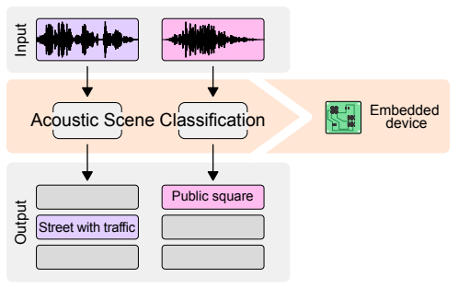
Flow of the proposed method

Slide 11
Applications:
machine hearing
smart home
scene monitoring
biological signal analysis

Slide 12
Hardware and Software Requirements:
Hardware & Software Requirements:
Software: Matlab R2018a.
Hardware:
Operating Systems:
• Windows 10
• Windows 7 Service Pack 1
• Windows Server 2019
• Windows Server 2016
Processors:
Minimum: Any Intel or AMD x86-64 processor
Recommended: Any Intel or AMD x86-64 processor with four logical cores and AVX2 instruction set support
Disk:
Minimum: 2.9 GB of HDD space for MATLAB only, 5-8 GB for a typical installation
Recommended: An SSD is recommended a full installation of all Math Works products may take up to 29 GB of disk space
RAM:
Minimum: 4 GB
Recommended: 8 GB

Slide 13
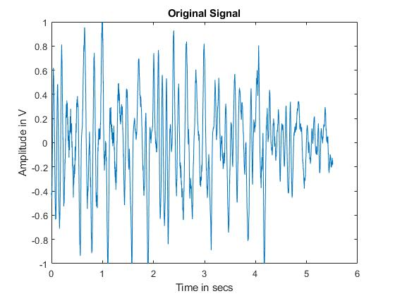
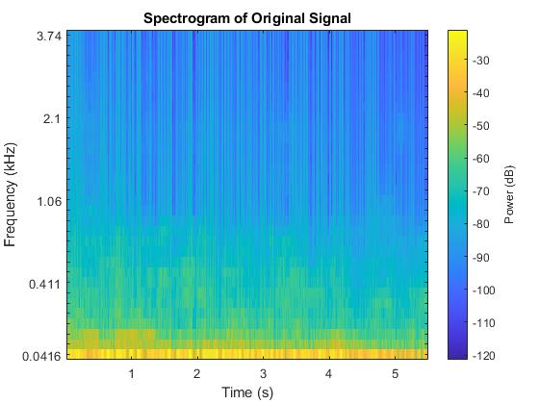
Results:

Slide 14
Conclusion:
This paper presented an analysis of the Low-Complexity Acoustic Scene Classification task in DCASE 2022 Challenge. The task was modeled after devices to bring the research problem closer to real-world applications. The number of multiply-and-accumulate operation set to 30 M and the total maximum number of parameters set to 128 K have been a sufficient constraint to receive a variety of interesting techniques, even though most systems were close to the imposed limits. The top systems employed large receptive fields, coordinate attention and transformer architectures to optimize performance, while quantization-aware training was the most used technique among participants to fulfill the complexity constrains. The number of submissions has decreased slightly from previous years, which may reflect the increased complexity of the task. However, the use of different devices for context-awareness is a sought after direction for applicability, therefore solutions suitable for limited computational power are needed. Moreover, the task could consider steering development towards solutions where room for improvement is still needed, like minimizing the working memory usage.

Slide 15
References:
E. Benetos, D. Stowell, and M. D. Plumbley, Approaches to Complex Sound Scene Analysis. Cham: Springer International Publishing, 2018, pp. 215–242.
[2] T. Heittola, A. Mesaros, and T. Virtanen, “Acoustic scene classification in DCASE 2020 challenge: generalization across devices and low complexity solutions,” in Proceedings of theDetection and Classification of Acoustic Scenes and Events2020 Workshop, Tokyo, Japan, November 2020, pp. 56–60.
[3] K. Koutini, F. Henkel, H. Eghbal-zadeh, and G. Widmer, “CP-JKU submissions to DCASE’20: Low-complexity cross-device acoustic scene classification with rf-regularized CNNs,” DCASE2020 Challenge, Tech. Rep., June 2020.
S. Suh, S. Park, Y. Jeong, and T. Lee, “Designing acoustic scene classification models with CNN variants,” DCASE2020Challenge, Tech. Rep., June 2020.

